Slide 1

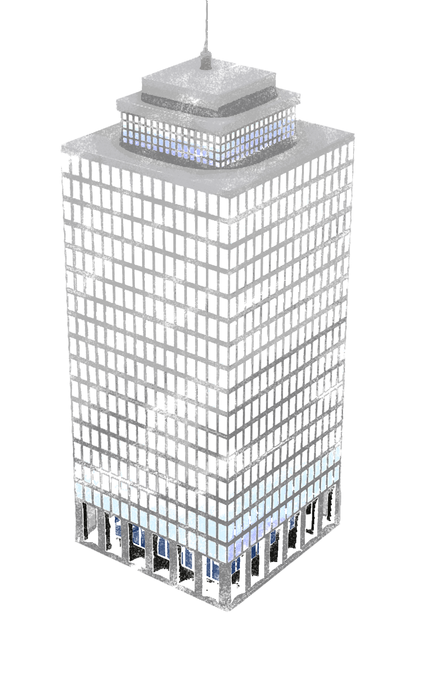

Danaher June 2015 Kaizen
AWS update, beliefs, strategy

Slide 2
We Believe IT should be
Fast,
Flexible,
Easy to Use
Notes:
In this presentation, we’ll look at how Enterprises are using AWS, but before we do so, let me give you a quick overview of AWS and why enterprises are choosing AWS for running their diverse workloads.

Slide 3
We Believe
In the fullness of time, most applications will be live in a cloud.
Running a very high volume global business at modest margins will be very attractive to customers. This is our model.
No customer ever wants to pay more for something.
Enterprise cloud adoption will be the biggest technological transformation of our generation, it will unleash tremendous competitive innovation.

Slide 4
AWS Update – since re:Invent
Most new services announced are available
2015 is trending well above 2014 rate of innovation, LOT of new things lined up for re:Invent 2015. Watch our blog.
Registration is open for 2015 re:Invent, Oct 6-9, Las Vegas, use code SALNAMMN for $400 discount (before June 9!)
Danaher annual quality survey – 6.93 – THANKS!!
Tons of activity across Danaher OpCo’s, critical mass building
New certification streams, lot of new training, 2100 ISVs now

Slide 5
Roadmap – AWS directional investment 515 new major features/services in 2014
Mobile/IoT/Connected Devices, 2lemetry, re:Invent unveil – Is Danaher/DL interested in Alpha access?
Major push towards Mobile Analytics, Kinesis, Lambda
Database-aaS – Aurora, RDBMS Migration tool, X-region red, larger DB sizes, major Redshift investment
Deployment & Management – making Amazon tools AWS services (Code Commit, Code Deploy, Code Pipeline, etc.)
Security – Encryption everywhere, tools to help you secure, AWS Config, auditing features, simplification
Simplification – quickstarts, packaged app environments, recipes

Slide 6
AWS Financials – Q1 broken out
FY14 AWS revenue of $4.6B
Q1FY15 revenue of $1.57B (49%CAGR), 17% operating margin
AWS represents 6% of AMZN revenue, earnings generator now
+1M customers, profitable, growing fast and we continue to invest in what our customers value
VMWare $1.51B, SFDC $1.23B, Rackspace $474M est (release 5/11/15)
Redshift – fastest growing, Marketplace is growing well above AWS CAGR
Flywheel – Customer Obsession -> Customers -> Scale -> Cost reduction -> Price reduction -> more Customers……

Slide 7
Danaher & AWS Advanced Track
Delivered
Using AWS Lambda & Mobile Services to support IoT/M2M
Danaher CoE Presentation
/* insert stock photo of attractive people doing something with mobile phones */
John Stamper – Danaher SA (stamperj@amazon.com)
Tim Meyer – Danaher AM (timmeyer@amazon.com )

Slide 8
Sample Future Topics – you tell us please!
Data Analysis at Scale – solution patterns for “big data” on AWS
Machine Learning – how EML is used for predictive analysis at Amazon
Compliance and the Cloud – approaches to solution compliance on AWS (HIPAA, FDA 21 CFR CH 11, PCI, etc..)
Security – advanced approaches to securing your workloads on AWS
Agile Design – How Amazon & AWS approach problems and structure teams, tools & processes to solve them in a scalable & frugal manner
The Frugal Cloud – how to improve the economics of your use of AWS
Bring us problems whose solutions would change your business, and we’ll bring you ideas, architectures, suggestions and team to discuss them with.

Slide 9
CALL TO ACTION
Registration is open for 2015 re:Invent, Oct 6-9, Las Vegas, use code SALNAMMN for $400 discount (before June 9!)
Contact Narendra is you have interest in Alpha exposure to IoT offers
What is missing? What could AWS be doing to add business value to your OpCo?
What is the next region?
What service should we build?
Features missing?
Are we missing ISV software in Marketplace?
Future topics for CoE? Call Jaime
How can we help you transform your business?

Slide 10
We Believe
IT
should be
Fast,
Flexible, and
Easy to Use
Notes:
In this presentation, we’ll look at how Enterprises are using AWS, but before we do so, let me give you a quick overview of AWS and why enterprises are choosing AWS for running their diverse workloads.

Slide 11
Cost – approaches to reducing cost of AWS
Scale of Platform – “Be a customer”, 48 price reductions to date, April 2014 saw wide and deep price reductions
Reserved Instances – buy a reservation, lower TCO 40-70%
Turn off servers when not in use (engineering, hygiene)
Right-size infrastructure – 50% reduction
Scale of Use (5-10% reduction on RI & S3 costs with use)
Trusted Advisor Tool to make recommendations (Bus/Ent Sup)
Continually optimize – tag everything, leverage the platform
EDP/EAP – modest discount/incentive for prepaid commitment to significant growth ($1M/yr min, 20% growth, 5% discount)
TCO support – AWS TCO team

